Slide 1
Software to Hardware in python
Motion detector sensor
Led light

Slide 2


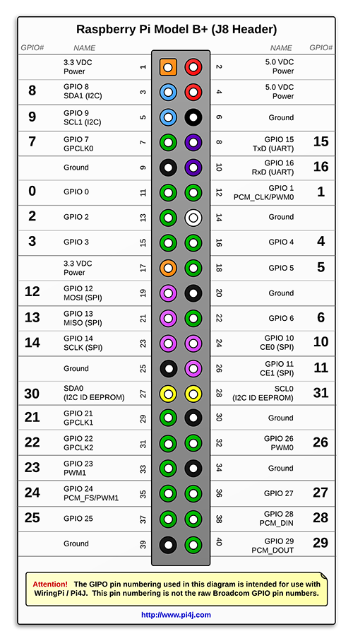
The gpio pins

Slide 3
Pir (passive infra Sensor)
Detect movement of objects that radiate IR light
Typically used to detect human movement
If sensor detects motion it will send a “1” to the Pi

Slide 4
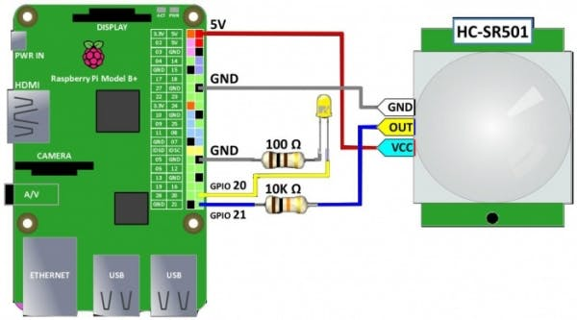
Schematic

Slide 5
The code
https://github.com/EmTech-PSU/Software-Hardware_Lab.git
Key Lines to understand:
Import module_name
GPIO.setmode(GPIO.BOARD)
GPIO.setup(pinNumber, GPIO.IN, pull_up_down=GPIO.PUD_DOWN)
GPIO.setup(pinNumber, GPIO.OUT)

